Slide 1

Azure CosmosDB
Santosh Hari
@_s_hari @AzureCosmosDB

Slide 2
Agenda
NoSQL concepts
Why CosmosDB
CosmosDB concepts
10 minute quickstart tutorial

Slide 3
Some NoSQL basics
CAP Theorem
Consistency, Availability and Parititioning
3Vs
Volume, Velocity and Variety

Slide 4
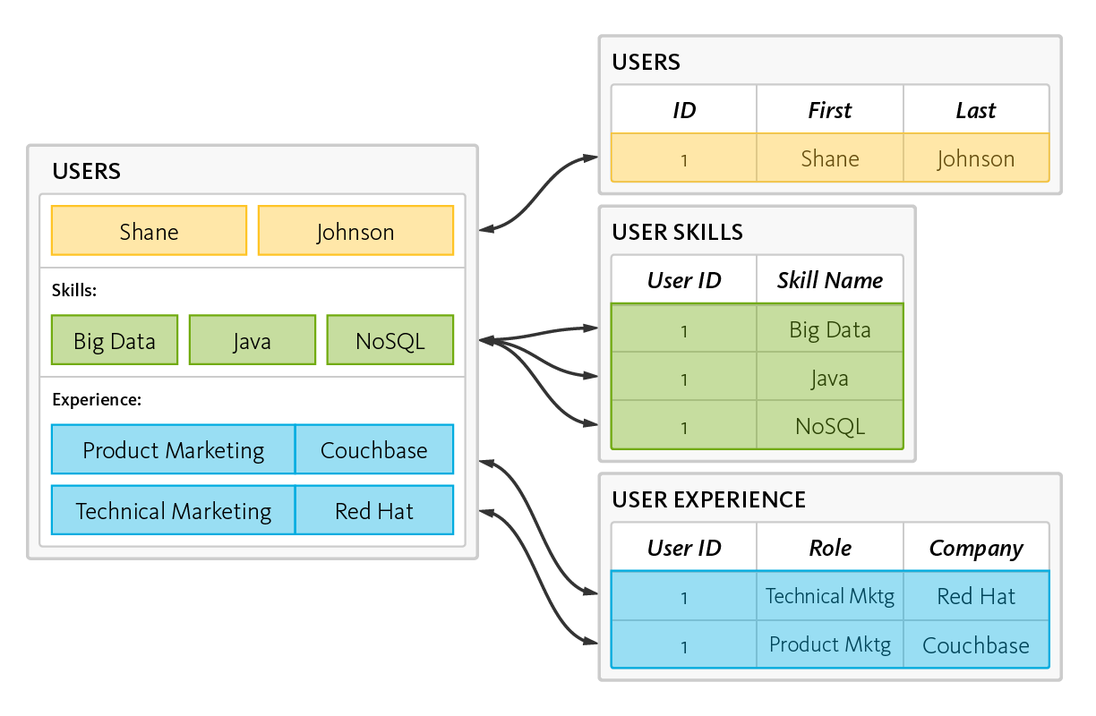
RDBMS – Reads, Writes, data shredding and reassembling
Notes:
data is read and written by disassembling, or “shredding,” and reassembling objects
This is the object-relational “impedance mismatch.” The workaround is object-relational mapping frameworks, which are inefficient at best, problematic at worst.

Slide 5
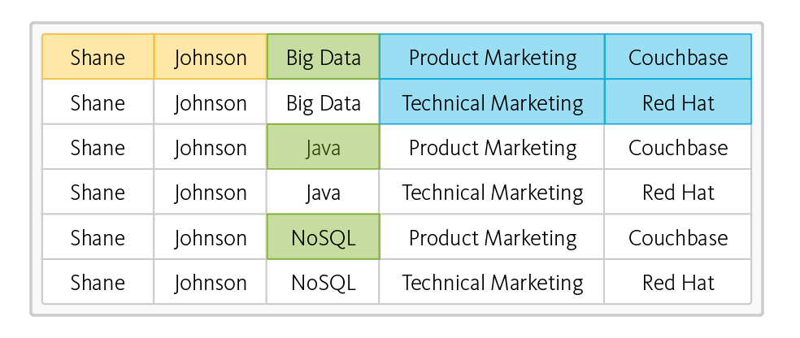
RDBMS – read operation – takes six rows from three tables
Impedance Mismatch
Notes:
This is the object-relational “impedance mismatch.” The workaround is object-relational mapping frameworks, which are inefficient at best, problematic at worst.

Slide 6
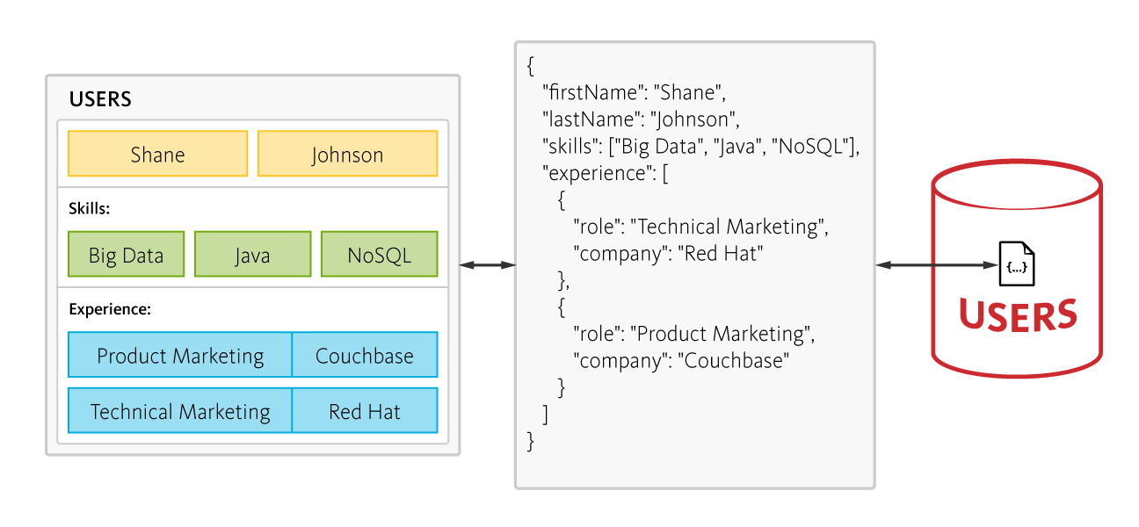
NoSQL – 6 rows of data, no joins, one fetch
Notes:
In contrast, a document-oriented NoSQL database reads and writes data formatted in JSON – which is the de facto standard for consuming and producing data for web, mobile, and IoT applications. It not only eliminates the object-relational impedance mismatch, it eliminates the overhead of ORM frameworks and simplifies application development because objects are read and written without “shredding” them – i.e., a single object can be read or written as a single document, as illustrated here:
DO NOT SWITCH SOLELY FOR THIS REASON!!!

Slide 7
RDBMS – Scale Vertical Single Server
Application
Concurrent Connections
L
Server load
M
S
Increase in Users
Notes:
Database has to be able to scale reads, writes, and storage
Several years ago, building performance into a software system was simple - you either increased your hardware resources (scale up) or modified your application to run more efficiently (performance tuning). Today, there’s a third option: horizontal scaling (scale out).

Slide 8
RDBMS – Scale Vertical Single Server
Concurrent Connections
Negative User Experience
Server efficiency
Postive User Experience
Server load
Unused
Capacity
Increase in Users
Notes:
Scaling up on single machine
User experience good until server efficiency reached
After exceeding server efficiency, user experience sucks
Almost half of capacity unused
Horizontal scaling – positives – unlimited scaling – negative – complexity
Data records vary across clients/nodes in different locations. Single points of failure destroy system up-time, and intermittent network issues creep up at the worst possible time

Slide 9
Scale horizontal many servers
Application
DocDB
DocDB
DocDB
Notes:
As application usage increases keep adding nodes
Even if nodes fail, system is able to keep responding
NoSQL scale out – run on commodity hardware on multiple nodes
Easy to add and remove nodes to handle loads
No single PoF
Flexibility in handling trade offs (CAP Theorem)

Slide 10
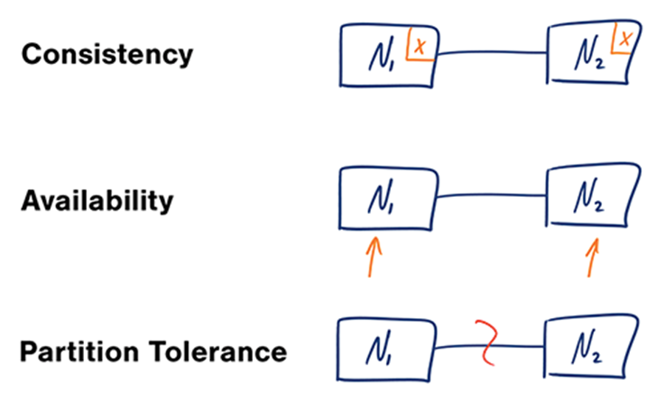
CAP Theorem
Notes:
Applies for distributed systems in general
Consistency - A read is guaranteed to return the most recent write for a given client.
Availability - A non-failing node will return a reasonable response within a reasonable amount of time (no error or timeout).
Partition Tolerance - The system will continue to function when network partitions occur.
Widely distributed aka networking factors comes into play. Object Oriented Programming != Network Programming.
One such fallacy of distributed computing is that networks are reliable. They aren’t. Networks and parts of networks go down frequently and unexpectedly. Network failures happen to your system and you don’t get to choose when they occur.

Slide 11
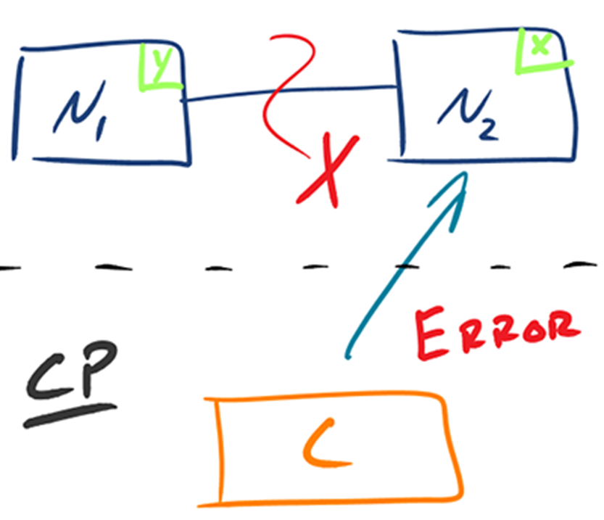
CAP Reality 1 – Consistent+Partition Tolerant
Notes:
Given that networks aren’t completely reliable, you must tolerate partitions in a distributed system, period. Fortunately, though, you get to choose what to do when a partition does occur.
Wait for a response from the partitioned node which could result in a timeout error
OR
The system can also choose to return an error, depending on the scenario you desire.
Choose Consistency over Availability when your business requirements dictate atomic reads and writes.

Slide 12
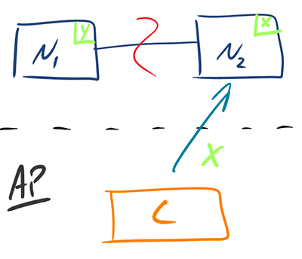
CAP Reality 2 – Availability + Partition Tolerant
Notes:
Return the most recent version of the data you have, which could be stale.
This system state will also accept writes that can be processed later when the partition is resolved.
Choose Availability over Consistency when your business requirements allow for some flexibility around when the data in the system synchronizes.
Availability is also a compelling option when the system needs to continue to function in spite of external errors (shopping carts, etc.)

Slide 13
ACID becomes BASE
Atomic Consistent Isolated Durable – relational
Basically Available Soft state Eventually consistent – NoSQL
Notes:
Basically available - Guarantees availability aka a response will get a request even if error
Soft State – changes over time and could even change when no incoming data because catching up
Eventual consistency – when writes stop for a while, system becomes consistent with time

Slide 14
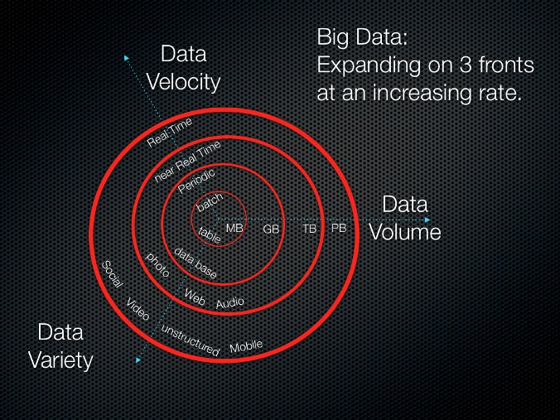
3Vs
Notes:
Volume: Facebook has over 250 billion images in 2015, ToDoList has 10 million installs
Velocity: Facebook has over 900 million photos/day.
Variety: Some large company CRMs have data in spreadsheets, docs, pdfs, audio, video, emails and so on

Slide 15
Types of NoSQL
Document databases - JSON documents. MongoDB
Graph stores - Neo4J and Giraph.
Key-value stores - Redis
Wide-column - Cassandra and Hbase
Notes:
Document databases pair each key with a complex data structure known as a document. Documents can contain many different key-value pairs, or key-array pairs, or even nested documents. MongoDB
Graph stores are used to store information about networks of data, such as social connections. Graph stores include Neo4J and Giraph.
Key-value stores are the simplest NoSQL databases. Every single item in the database is stored as an attribute name (or 'key'), together with its value. Examples of key-value stores are Riak and Berkeley DB. Some key-value stores, such as Redis, allow each value to have a type, such as 'integer', which adds functionality.
Wide-column stores such as Cassandra and HBase are optimized for queries over large datasets, and store columns of data together, instead of rows.

Slide 16


One database to rule them all
Notes:
What if you could have one database to rule them all?
What if the biggest cloud provider
What if this database system was cloud bas and went planet scale with a few mouse clicks?
Enter C
What would supports multiple data models: key-value, documents, graphs.
In true NoSQL fashion, write optimized to ingest high volumes of data at high velocities
Completely managed
schema-agnostic database engine to store variety of data
Supports many APIs for accessing data including MongoDB, DocumentDB SQL, Gremlin (preview), Cassandra (preview) and Azure Tables (preview), in an extensible manner.
Coming soon: HBase

Slide 17
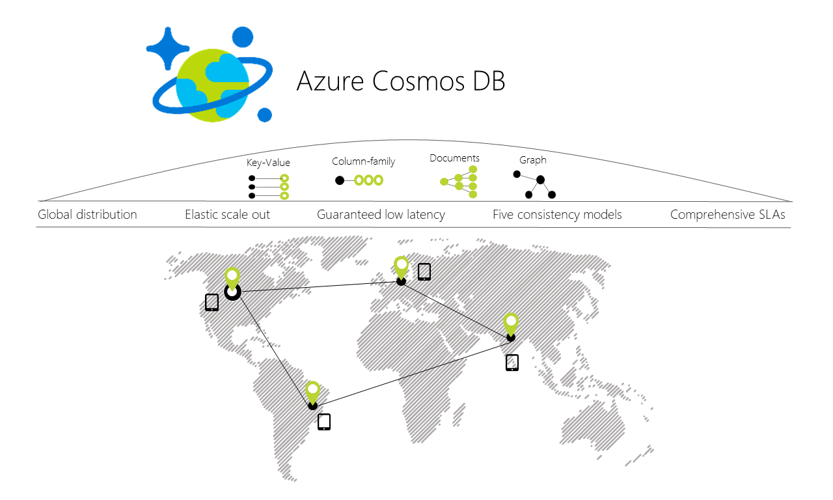
CosmosDB
Notes:
History of CosmosDB – Project Florence 2010, DocumentDB 2015, CosmosDB 2017
First class service on azure, which means new datacenter will always have cosmosdb

Slide 18
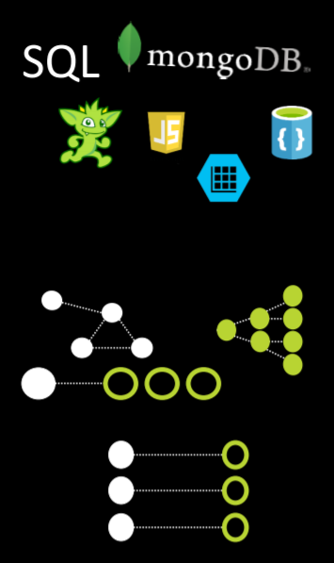
Multi-model, multi-API
5 offerings – DocumentDB (SQL), MongoDB, Table*, Graph (Gremlin), Cassandra*
Atom-Record-Sequence
Polyglot!!!
Notes:
Data models including documents, key-value, graph
Cosmos DB’s database engine currently supports DocumentDB SQL, MongoDB, Azure Tables (preview), Cassandra (preview) and Gremlin.
ARS
DB engine translates and projects different data models onto the ARS-based model.
Atom-Record-Sequence
Atom: primitive types string, bool, and number
Record: Structs composed of atoms and other records
Sequences: Atoms, Records and other Sequences
Core data model natively accessible from dynamically typed programming languages and exposed as-is as JSON.
The service also supports popular database APIs for data access and querying.
Ideal for Polyglot persistence

Slide 19
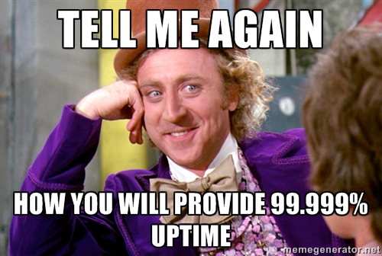
SLA
Latency
Throughput
Consistency
Availability
Fine print: Within a region
Fine print: SLA depends on lowest metric
Notes:
It offers throughput, latency, availability, and consistency guarantees with comprehensive service level agreements (SLAs)

Slide 20
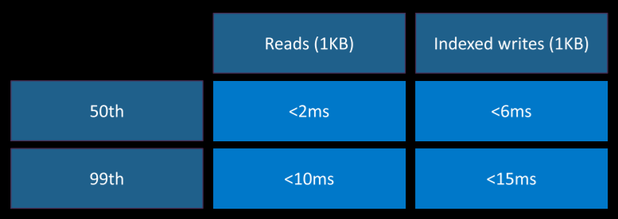
Latency - @ P99
Globally distributed with reads and writes served from local region
Write optimized, latch-free database engine designed for SSDs and low latency access
Synchronous and automatic indexing at sustained ingestion rates
Notes:
Guaranteed low latency with P99
Within one hour of adding a new region will start performing at P99

Slide 21
Throughput - Currency RU/s
Measured in RUs, 1 RUs = throughput for a 1KB document/second
Create document | ~15 RU
Read document | ~1 RU
Query document by id | ~2.5 RU
Query | Request Unit Charge | # of Returned Documents
Select food by id | ~2.5 RU | 1
Select foods by manufacturer | ~7 RU | 7
Select by food group and order by weight | ~70 RU | 100
Select top 10 foods in a food group | ~10 RU | 10
Notes:
Throughput = amount of items passing through a system (in and out)
RU is the bitcoin of CosmosDB

Slide 22
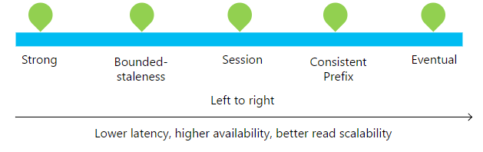
Consistency (from CAP)
 | Strong | Bounded Staleness | Session | Consistent Prefix | Eventual
Regions | One | Multiple | Multiple | Multiple | Multiple
Throughput Cost | Costliest read | Costliest read | Medium cost read | Medium cost read | Cheapest read
Reading writes | Guaranteed | Guaranteed same region | RYW | R in order of W | R may be out of order of W
Notes:
Horizontal scaling
Data is stored across many nodes within a region and across multiple regions
Defines how writes are stored
Session is most commonly used
Consistency directly impacts RU for writes
Strong – closes to traditional relational DB (ok to do some this wau)
Bounded staleness – can specify treshold for read inconsistency
Session – write-read are traditional within that connection session
Consistent prefix – reads lag but in same sequence as writes
Eventual – consistent at some point but not right away usually

Slide 23
Availability
99.999%
One-click deploy
Simulate failure
Notes:
99.99% Availability within a single region
One-click deploy to multiple regions
Turn regions on and off to simulate failure

Slide 24
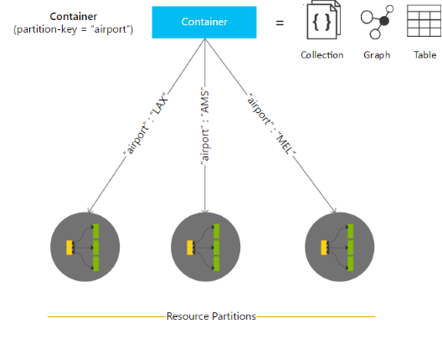
Availability - Partitioning
Notes:
Stores data in collections
Number of partitions is based on storage size
Partitions managed by CosmosDB – transparent to app, handles distributing data and rerouting queries
Partition Key + Row Key
pick a good partition key when you create your container. There are two key considerations for choosing a partition key:
Boundary for query and transactions, No storage and performance bottlenecks
If you’re implementing a user profile backend, then the user ID is a good choice for partition key.
If you’re storing IoT data for example, device state, a device ID is a good choice for partition key.

Slide 25
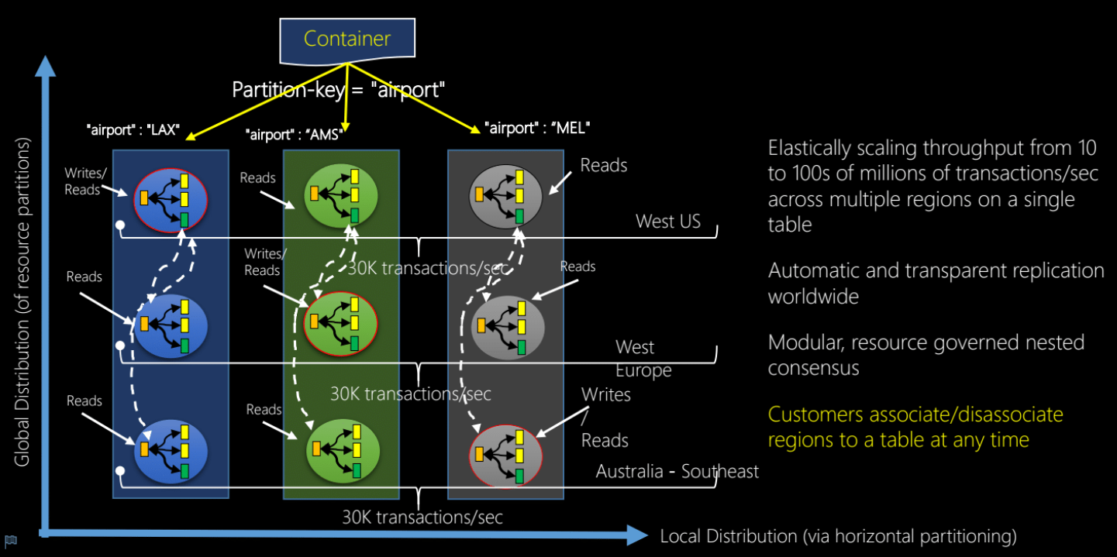
Availability - Global Distro
Notes:
2 dimensions:
Within a given region, all resources are horizontally partitioned using resource partitions (local distribution).
Each resource partition is also replicated across geographical regions (global distribution).
When scaling, CosmosDB automagically manages across regions keeping single system image
Turnkey with few clicks can add regions
New regions start operating with 99 percentile under 1 hour

Slide 26
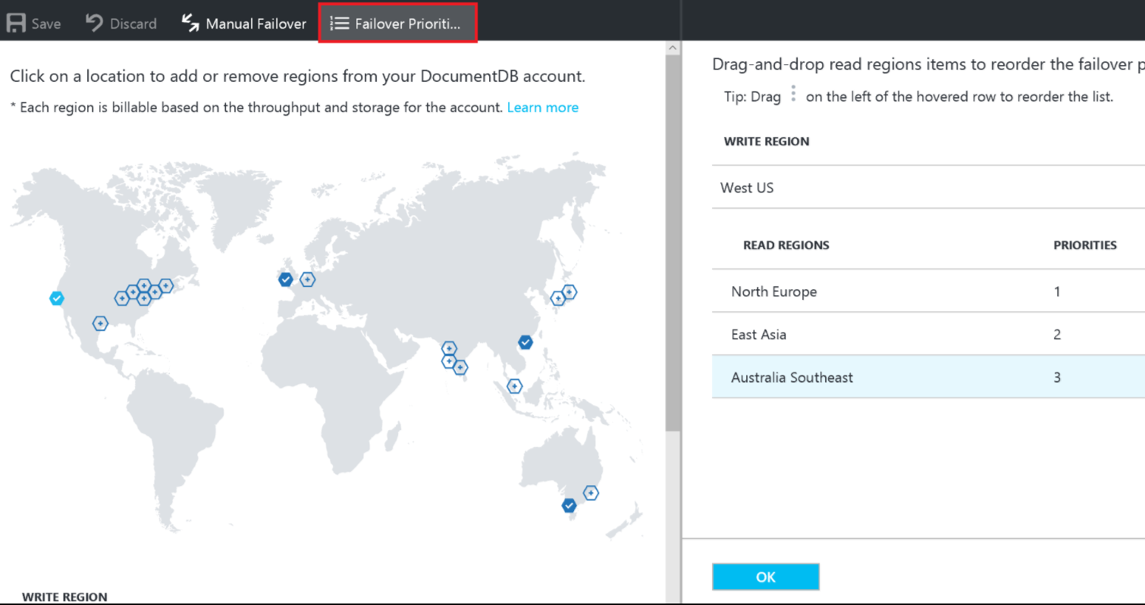
Availability - Transparent multi-homing
Notes:
Dynamically associate "priorities" to the regions to direct the requests to specific regions in the event of regional failures.
In an unlikely event of a regional disaster, Cosmos DB automatically failovers in the order of priority.
To test the end-to-end availability of the application, you can manually trigger failover (rate limited to two operations within an hour).
zero data loss during manual regional failovers. upper-bound on data loss during the system-initiated automatic failover.
You do not have to redeploy your application after a regional failover, and availability SLAs are maintained by Azure Cosmos DB.
CDN but for a database

Slide 27
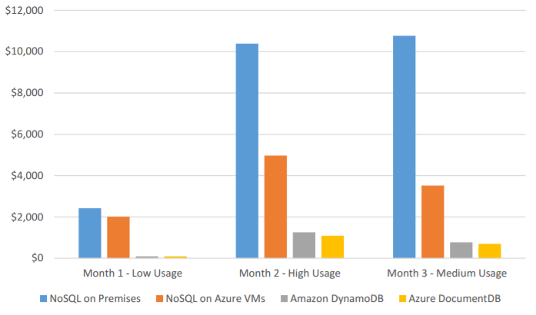
TCO: Total cost of (non)ownership
Notes:
My #1 reason:
OSS NoSQL database like Cassandra or MongoDB hosted on-premises
OSS NoSQL database hosted on Azure Virtual Machines
Using a managed NoSQL database as a service such as Azure DocumentDB.
No NoSQL administration dev/ops required. managed cloud service, you do not need a dev/ops team to handle deployments, maintenance, scale, patching and other day-to-day tasks required with an OSS NoSQL cluster hosted on-premises or on cloud infrastructure.
Superior elasticity throughput can be scaled up and down within seconds, allowing you to reduce the cost of ownership during non-peak times. OSS NoSQL clusters deployed on cloud infrastructure offer limited elasticity, and on-premises deployments are not elastic.
Economy of scale. Managed services operating really large number of nodes, and are able to pass on savings to the customer.
Cloud optimized. Managed services take full advantage of the cloud. OSS NoSQL databases at the moment are not optimized for specific cloud providers. For example, OSS NoSQL software is unaware of the differences between a node going down vs a routine image upgrade, or the fact that premium disk is already three-way replicated.

Slide 28
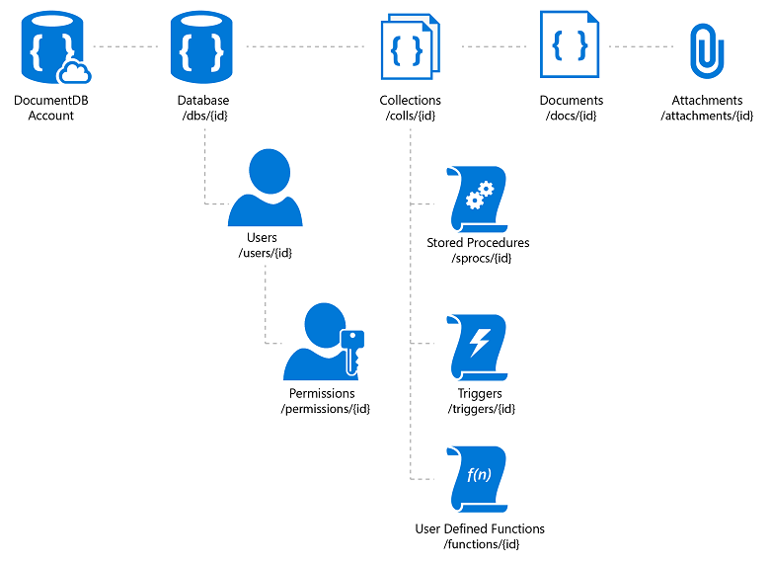
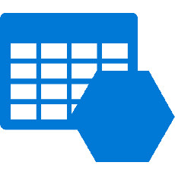
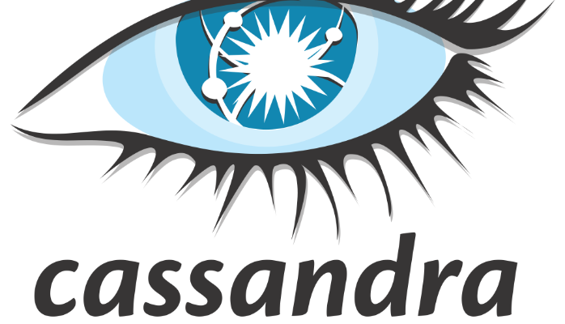

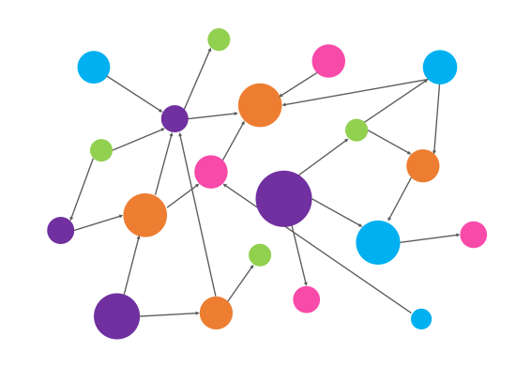
Structure
Notes:
A database account consists of a set of databases, each containing multiple collections, each of which can contain stored procedures, triggers, UDFs, documents/graphs/tables/keyspaces. A database also has associated users, each with a set of permissions to access various other collections, stored procedures, triggers, UDFs, documents, or attachments. While databases, users, permissions, and collections are system-defined resources with well-known schemas - documents, stored procedures, triggers, UDFs, and attachments contain arbitrary, user defined JSON content.
Documents – managed (upload blob) unmanaged (link)

Slide 29
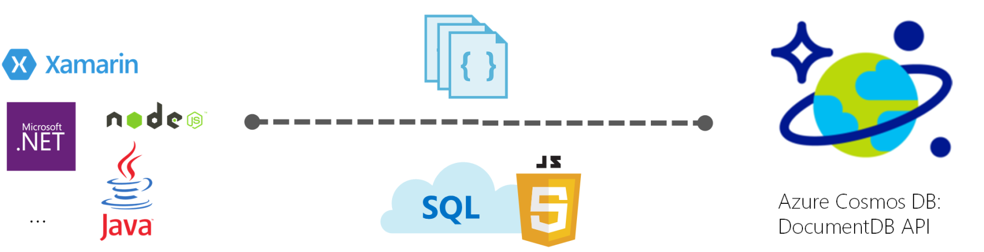
1. DocumentDB
Document Oriented NoSQL database
Schema-less JSON data
SQL query capabilities
Notes:
With the DocumentDB API, Azure Cosmos DB provides rich and familiar SQL query capabilities with consistent low latencies over schema-less JSON data. In this article, we provide an overview of the Azure Cosmos DB's DocumentDB API, and how you can use it to store massive volumes of JSON data, query them within order of milliseconds latency, and evolve the schema easily.

Slide 30
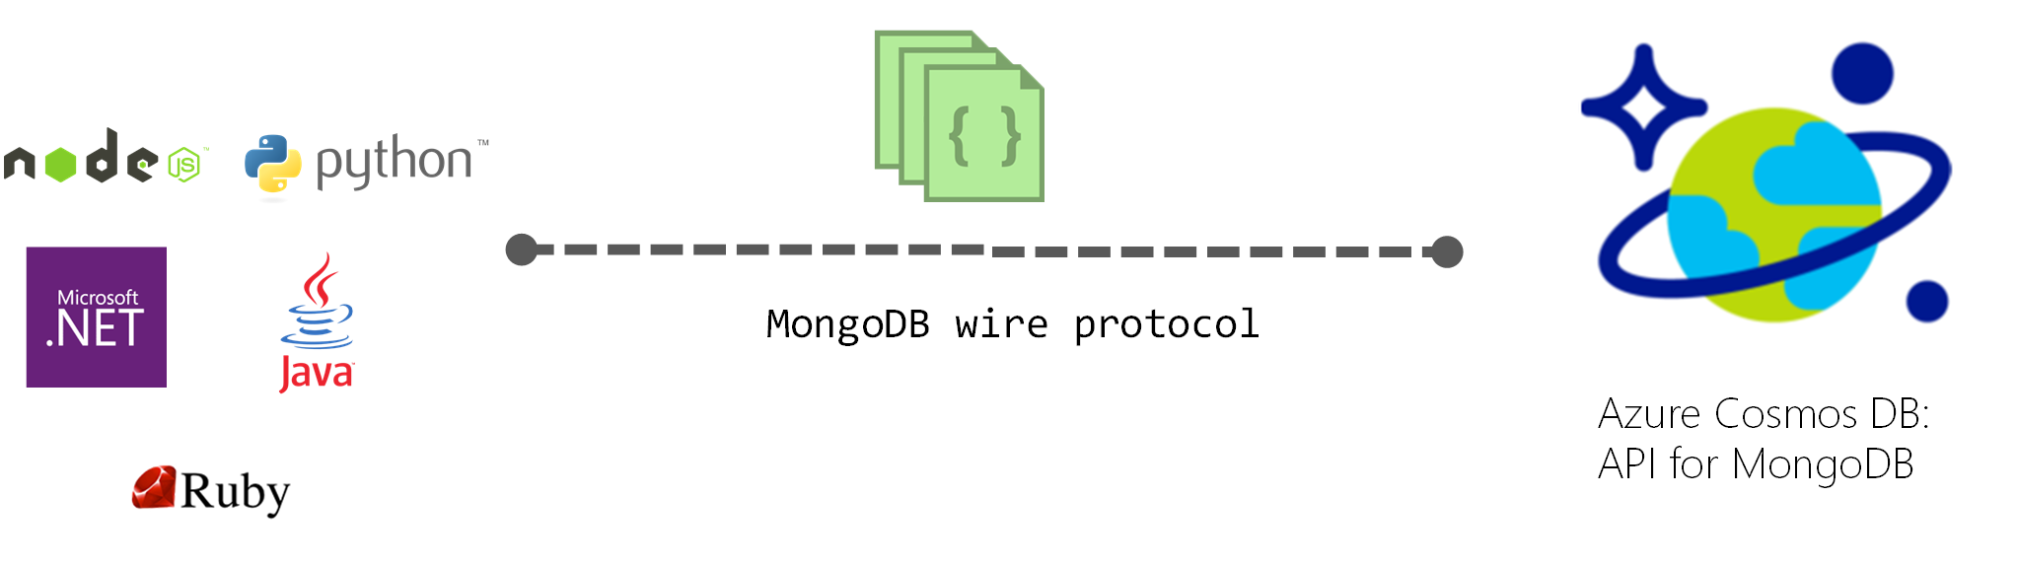
2. MongoDB
Document Oriented NoSQL database
Notes:
Cosmos DB databases can be used as the data store for apps written for MongoDB. This means that by using existing drivers, your application written for MongoDB can now communicate with Cosmos DB and use Cosmos DB databases instead of MongoDB databases. In many cases, you can switch from using MongoDB to Cosmos DB by simply changing a connection string. Using this functionality, you can easily build and run MongoDB database applications in the Azure cloud with Azure Cosmos DB's global distribution and comprehensive industry leading SLAs, while continuing to use familiar skills and tools for MongoDB.

Slide 31
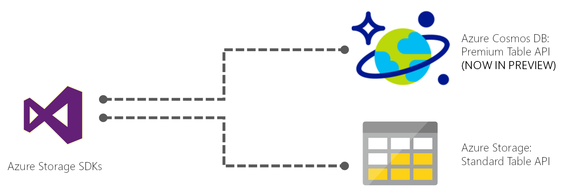
3. Table Storage
Key-Value NoSQL storage
Same as Azure Table Storage but premium
In Preview currently!!
Notes:
Azure Cosmos DB provides the Table API for applications that need a key-value store with flexible schema. Azure Table storage SDKs and REST APIs can be used to work with Azure Cosmos DB. You can use Azure Cosmos DB to create tables with high throughput requirements. Azure Cosmos DB supports throughput-optimized tables (informally called "premium tables"), currently in public preview.
You can continue to use Azure Table storage for tables with high storage and lower throughput requirements. Azure Cosmos DB will introduce support for storage-optimized tables in a future update, and existing and new Azure Table storage accounts will be upgraded to Azure Cosmos DB.

Slide 32
3. Table Storage
Pros:
Simple queries
Simple data-modeling
Cons:
Bad for returning large datasets.
Bad at relational data
Bad at aggregation.
Notes:
Pro: Supports simple queries very efficiently. Very simple data-modeling pattern, should be understandable by anyone.
Con: The only queries that are efficient are simple, one-row-at-a-time queries.
Not really a data model at all, in that there's no association between attributes that form an entity.
Hard to use most ordinary SQL operations such as JOIN or GROUP BY.
You can't choose an appropriate SQL data type for the value.
You can't use many SQL constraints such as FOREIGN KEY or NOT NULL.
Pivoting the result to resemble a conventional result (one column per attribute) is a complex and expensive query.
You have to write a lot more application code to reassemble collections of key/value pairs into objects.

Slide 33
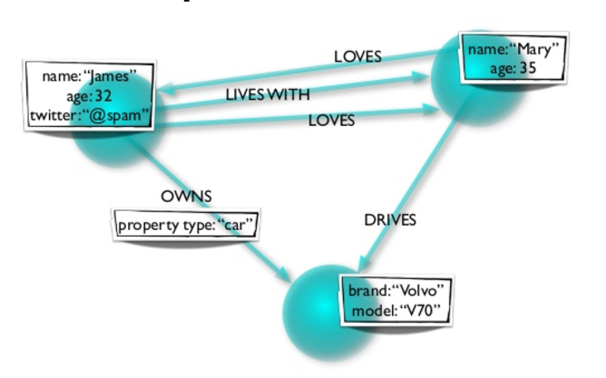
4. Graph (Gremlin)
Notes:
Data as it appears in the real world is naturally connected. Traditional data modeling focuses on entities. But for many applications, there is also a need to model the rich relationships between entities. Graphs allow you to model both entities and relationships naturally.
A graph is a structure composed of vertices and edges. Both vertices and edges can have an arbitrary number of properties. Vertices denote discrete objects such as a person, a place, or an event. Edges denote relationships between vertices. For instance, a person may know another person, have been involved in an event, and/or was recently at a particular place. Properties express information about the vertices and edges. Example properties include a vertex having a name, an age, and an edge having a timestamp and/or a weight. More formally, this model is known as a property graph. Azure Cosmos DB supports the property graph model.

Slide 34
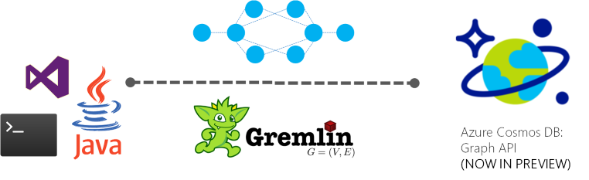
4. Graph (Gremlin)
Graph NoSQL storage
Graph computing framework – Apache Tinkerpop
Graph traversal language – Gremlin
Super relational
Notes:
Azure Cosmos DB provides graph modeling and traversal APIs along with turn-key global distribution, elastic scaling of storage and throughput, <10 ms read latencies and <15 ms at p99, automatic indexing and query, tunable consistency levels, and comprehensive SLAs including 99.99% availability. Azure Cosmos DB can be queried using Apache TinkerPop's graph traversal language, Gremlin, and integrates with other TinkerPop-compatible graph systems like Apache Spark GraphX.

Slide 35
4. Graph (Gremlin)
Pro: Fast relationship queries
Pro: Fast to traverse nodes
Pro: Multiple dimensions
Con: Bad in transactions
Con: Bad at aggregation
Notes:
PROS
really fast queries when you are looking for relationships between nodes
Fast to traverse nodes
Can represent multiple dimensions
CONS
Inappropriate for transactional information, like accounting records where relationships between records are simpler
Harder to do summing queries and max queries efficiently - counting queries not harder
Usually need to learn a new query language like Gremlin
Fewer vendors to choose from, and smaller user base, so harder to get support when you run into issues

Slide 36
5. Cassandra
Column Oriented Database
Clusters by columns instead of rows
Notes:
By grouping columns together you can often load entire set of columns in memory for super fast calculations
Partition using logical partition keys
Best for range based calculations
Great use case is time series data like web analytics

Slide 37
Quickstart Tutorial

Slide 38
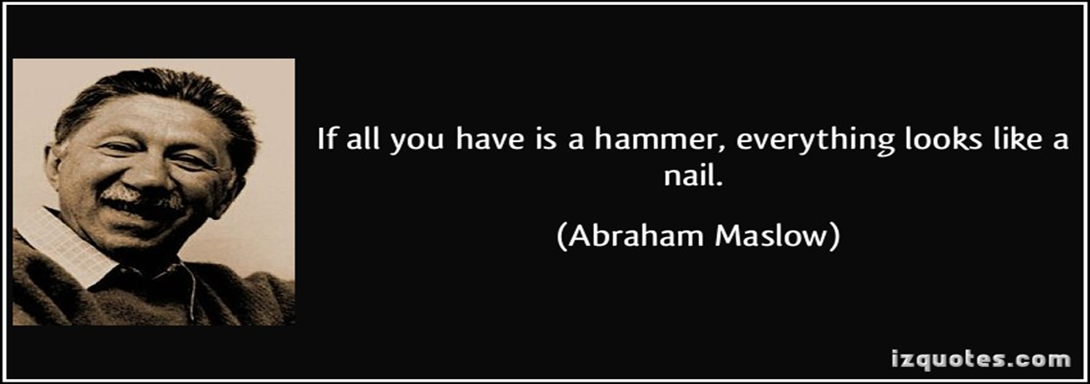

Slide 39
Resources
Local emulator https://docs.microsoft.com/en-us/azure/cosmos-db/local-emulator#developing-with-the-emulator
Throughput planner https://www.documentdb.com/capacityplanner
CosmosDB docs https://docs.microsoft.com/en-us/azure/cosmos-db/
Graph Code samples https://github.com/Azure-Samples/azure-cosmos-db-graph-dotnet-getting-started
Table Code Samples https://github.com/Azure-Samples/azure-cosmos-db-table-dotnet-getting-started
Mongo Code Samples https://github.com/Azure-Samples/azure-cosmos-db-mongodb-dotnet-getting-started
TinkerPop and Gremlin docs http://tinkerpop.apache.org/docs/current/
Azure Search (elastic search and CosmosDB) https://docs.microsoft.com/en-us/azure/search/search-howto-index-documentdb

